Slide 1

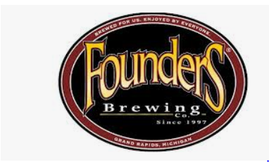
U.S. BEER TREND
LEUNG & RICHARDSON DATA ANALYTICS GROUP
https://youtu.be/RW-_SRXuM0k

Slide 2
PURPOSE
Founders Brewery
Fastest growing craft brand in the U.S.
New markets
Leung and Richardson Data Analytics Group
Research
Opportunities
Analysis
Identify the number breweries within each state
Determine the median ABV and IBU from each state
Identify the states with the highest ABV and IBU
Relationship association

Slide 3
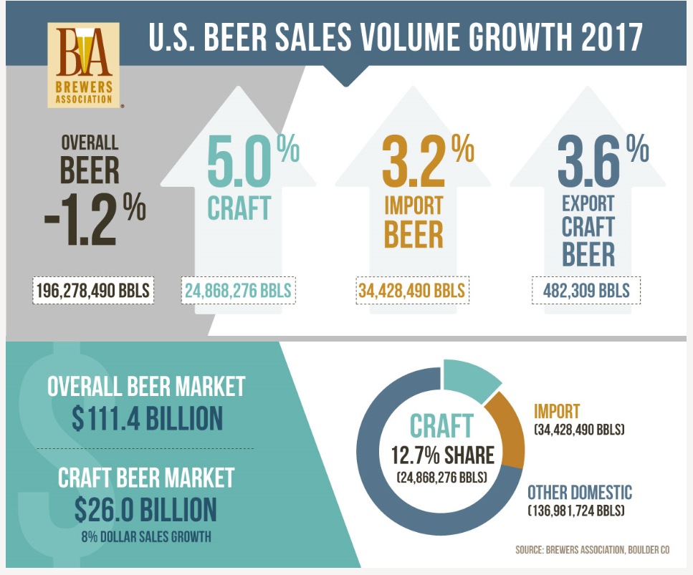
BREWERS ASSOCIATION FOR SMALL AND INDEPENDENT CRAFT BEERS
Overall U.S. beer volume sales were down
1% in 2017
Craft beer sales continued to grow at a rate of
5% by volume.
Craft retail sales increased 8%, up to $26.0 Billion
Craft accounts for more than 23% of the $114 billion
U.S. beer market
https://www.brewersassociation.org/statistics/national-beer-sales-production-data/

Slide 4
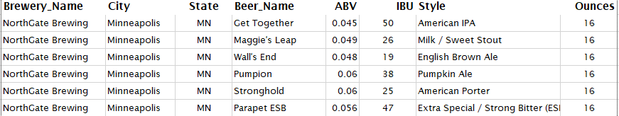
Data Review
Detected missing values
1005 out of 2410 (41.7%) didn’t have
have an IBU value
62 out of 2410 (2.57%) did not have a
a ABV value
Occurrences of missing values eliminated
 | Brewery_id | Beer_Name | Beer_ID | ABV | IBU | Style | Ounces | Brewery_Name | City | State
N/A Counts | 0 | 0 | 0 | 62 | 1005 | 0 | 0 | 0 | 0 | 0
Total Counts | 2410 | 2410 | 2410 | 2410 | 2410 | 2410 | 2410 | 2410 | 2410 | 2410
% of N/A | 0.00% | 0.00% | 0.00% | 2.57% | 41.70% | 0.00% | 0.00% | 0.00% | 0.00% | 0.00%

Slide 5
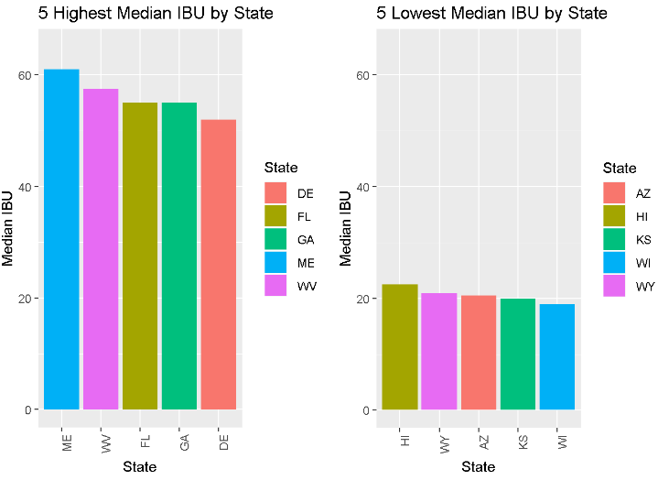
MEDIAN IBU FOR U.S. HIGHEST AND LOWEST STATES
Median IBU by State
Range between 10 to 82 - Top 5
Range between 7 to 110 - Bottom 5
Greater variation in the median IBU for bottom 5

Slide 6
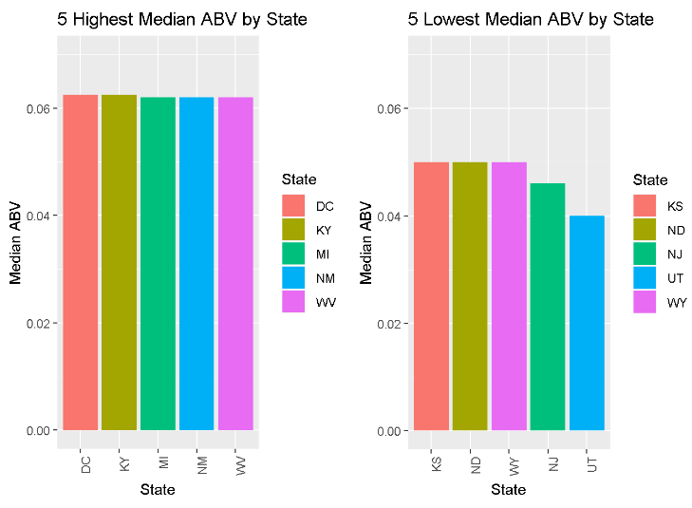
MEDIAN ABV FOR U.S. HIGHEST AND LOWEST STATES
Median ABV by State
Range between 0.038 to 0.125 - Top 5
Range between 0.039 to .099 - Bottom 5
Roughly same variation in the median ABV

Slide 7
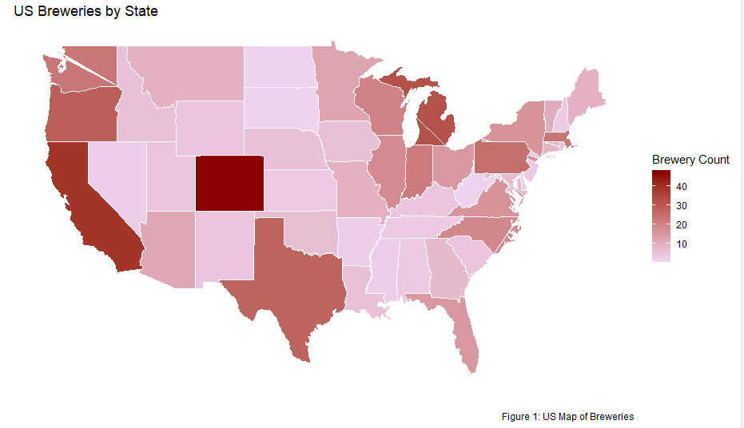
BREWERIES PRESENCE IN EACH STATE
Highest States Presence - Colorado with 47 and California 39
Top 5 states accounts for 31% of all U.S. Breweries
Lowest States Presence

Slide 8
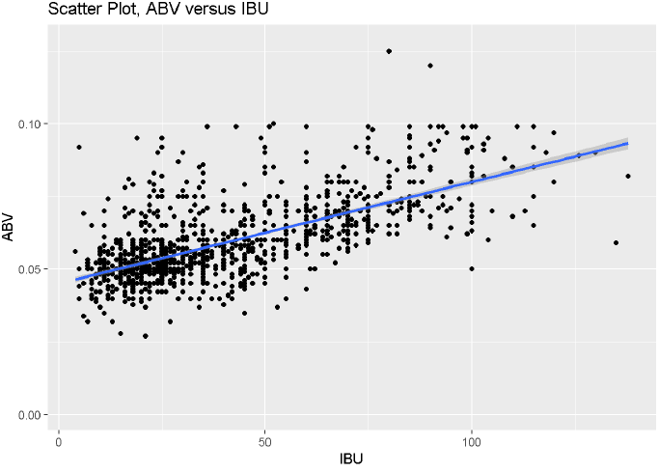
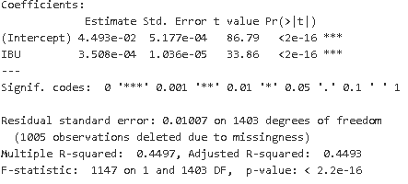
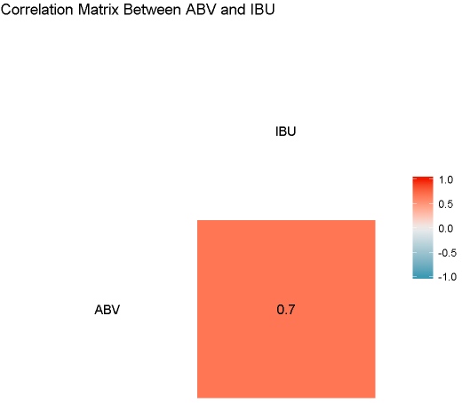
RELATIONSHIP BETWEEN IBU AND ABV
Null: Slope is equal to zero. Alternative: Slope is not equal to zero.
Reject Null
p-value: < 2.2e-16 (α=0.05) Adjusted R-squared 0.4493 (~45% of the variance of ABV can be explained by IBU)

Slide 9
SUMMARY
Congrats on success 48th state distribution to Wyoming
Further research
Utah
Hawaii

